Slide 1


Making the Most of the Preseason
TEAM 4150

Slide 2
What is the preseason?
The time between your last formal competition and kickoff the following year
~April through December
To be a fully effective team this time should be used to build skills, promote teamwork and ensure resources are in place to support a successful build season.
Building a team while also building a robot is like changing your tires while driving down the highway…

Slide 3
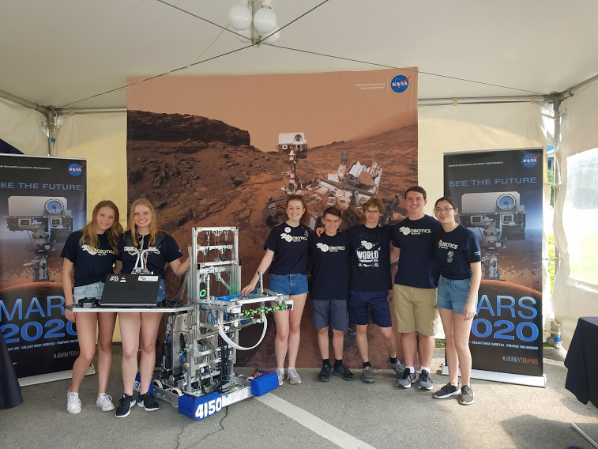
Importance of the offseason
Making connections with the community through outreach and sponsorships
Looking at the accomplishments of Chairman's award winners shows that they are active year round
Not surprisingly, these teams also tend to do well at regional competitions

Slide 4
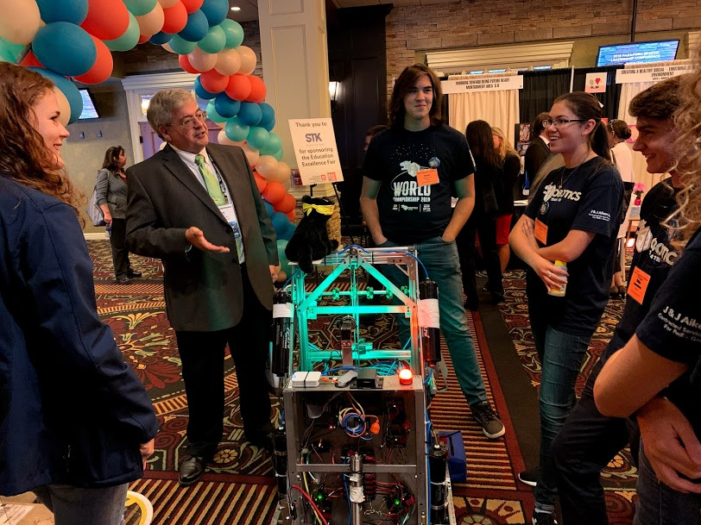
Outreach
Build a relationship with your community and school with outreach events
Relay for Life
Middle & elementary schools
High school club fair
Remake Learning Days
School board & State School Board Association
Rotary Club & Lions Club
Girl Scouts / Boy Scouts
FRC 4150 students speaking to administrators at the 2019 Pennsylvania School Board Association Conference.

Slide 5
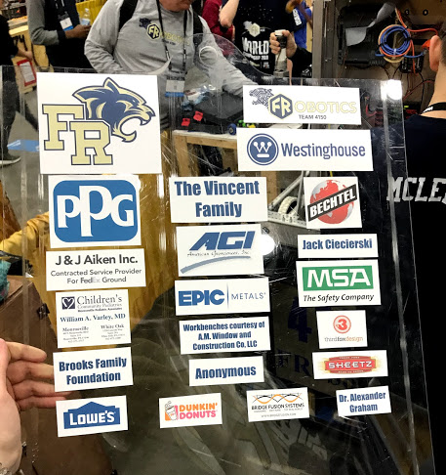
Fundraising
ESSENTIAL to a successful team
Fundraising needs to happen early & often
Fundraising Ideas:
Reach out to local companies
School District
Community events
Traditional fundraisers
Remember to honor your sponsors by displaying their names/logos on your website, robot, or clothing!
FRC 4150 robot sponsor panel

Slide 6
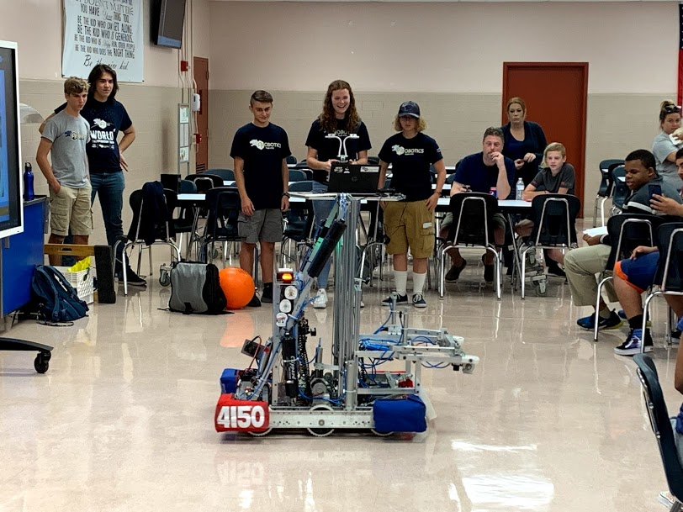
Teambuilding
New members
School club day & demonstrations to 8th graders
Developing good team chemistry
Create opportunities for new members to integrate into the team
FRC 4150 demonstrates their robot for new potential FRC students

Slide 7
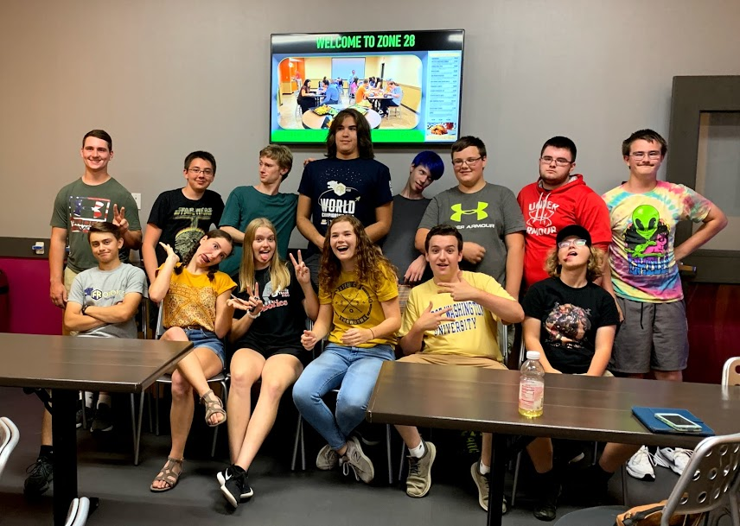
Teambuilding Model
Forming, Storming, Norming, Performing – Go through the steps and try not to get stuck, especially in the storming phase
Use both robot related team activities and other fun activities (laser tag, movie night, etc.)
FRC 4150 students at a laser tag teambuilding event

Slide 8
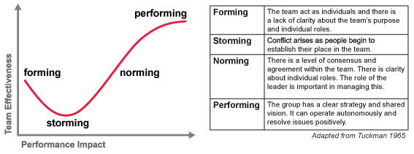
Teambuilding Model
(source: medium.com)

Slide 9
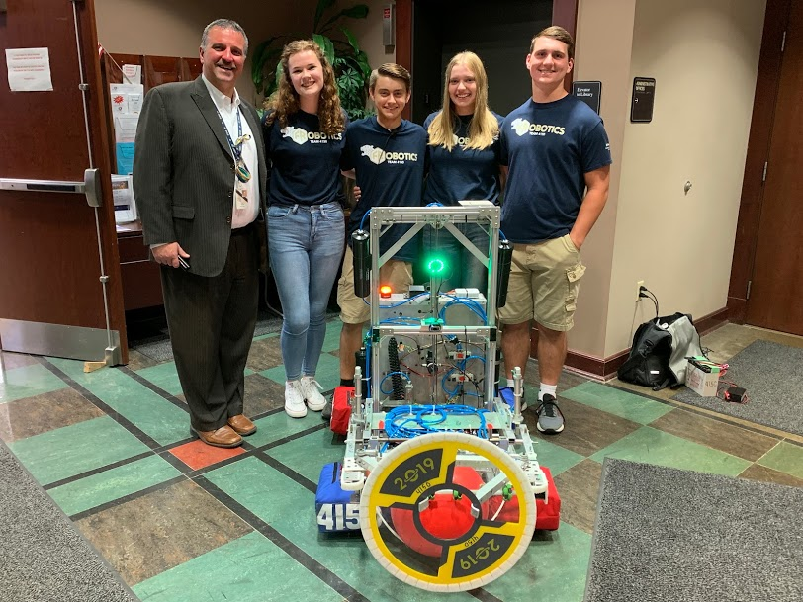
Administrative Teambuilding
Selecting team leadership (mentors)
Define team goals
Competition scheduling
Awards to pursue
Develop / revise student handbook
Meet with Parents
Hopefully identify some new mentors
Define expectations for communication
Define student expectations
FIRST Choice selections and other administrative items
FRC 4150 officers present to the School Board at the start of each school year

Slide 10
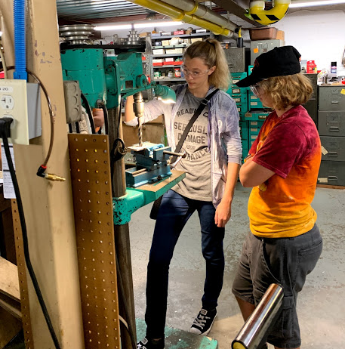
Safety Training
Prepare students for using tools in the workshop
Get them ready to be productive before the season starts so time is not wasted on introductory training during the build season
Train on all common tools, safety equipment, and measuring tools
Tailor training to the tools available and commonly used in your workshop
FRC 4150 students learning to use the drill press

Slide 11
Safety Training Examples
Band saw
Set guard height to just above work piece but with room to see cut line
Use fence or protractor when possible
Keep fingers away from blade
The end of the cut is most dangerous.
Make relief cuts first to facilitate final cut.
Smooth pressure on the piece, let the blade do the work
Use blade lubricant before you start
Drill press
Foot control can be accidently activated, watch where you place it
Clamp work pieces whenever possible
If not possible to clamp be sure to control the workpiece.
Use center drill when you want precision
Make sure bit is tight in the chuck
For thick metal pieces use lubricant
Let the bit do the work with steady pressure. If not cutting smoothly sharpen the bit.

Slide 12
Safety Training Examples (cont’d)
Hack saw / file
Clamp piece in the vice
Cut on the push stroke, release pressure on the pull stroke.
Keep the blade straight, don't let it bind
This is a skill, it takes some practice
Be careful for "line of fire" - if you slip you don't want to catch your arm on any sharp edges.
Measuring tools
Machinist square - how to disassemble and reassemble
Measuring tape - note slider on the end.
Calipers - different types
Micrometer - major marks are 0.1" - minor marks are 0.025" - marks on the barrel are 0.001"
We also discuss different types of drill bits (number drill, letter drills and fractional drill) at this time

Slide 13
Safety Training Examples (cont’d)
Sander
watch your knuckles
on sanding disk, pay attention to direction of rotation, always sand on the downward rotation side
use light pressure, let the sander do the work.
General Safety
Safety Glasses always
Gloves only when appropriate, not on rotating equipment
No horsing around
Know what's going on around you
Do not use tools you have not been trained on
Line of fire (what happens if you slip or something breaks)
Control your work pieces
DO NOT LEAVE THE CHUCK KEY IN THE DRILL PRESS
Use equipment only as intended, hold work firmly against the fence
Be careful of chemical hazards, some of the things we use can be harmful to you.

Slide 14
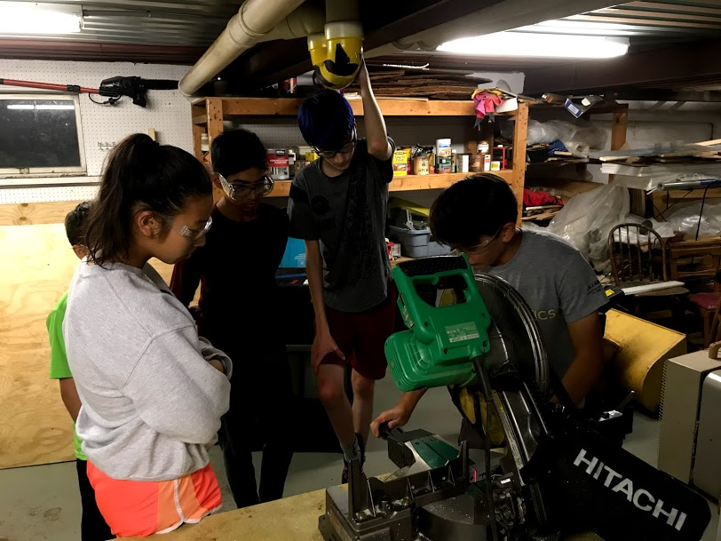
Just in Time Safety Training
Just in time (JIT) refresher training during the season
Use JIT training for less commonly used tools as needed during the build season
FRC 4150 students learning to use the chop saw using JIT training

Slide 15
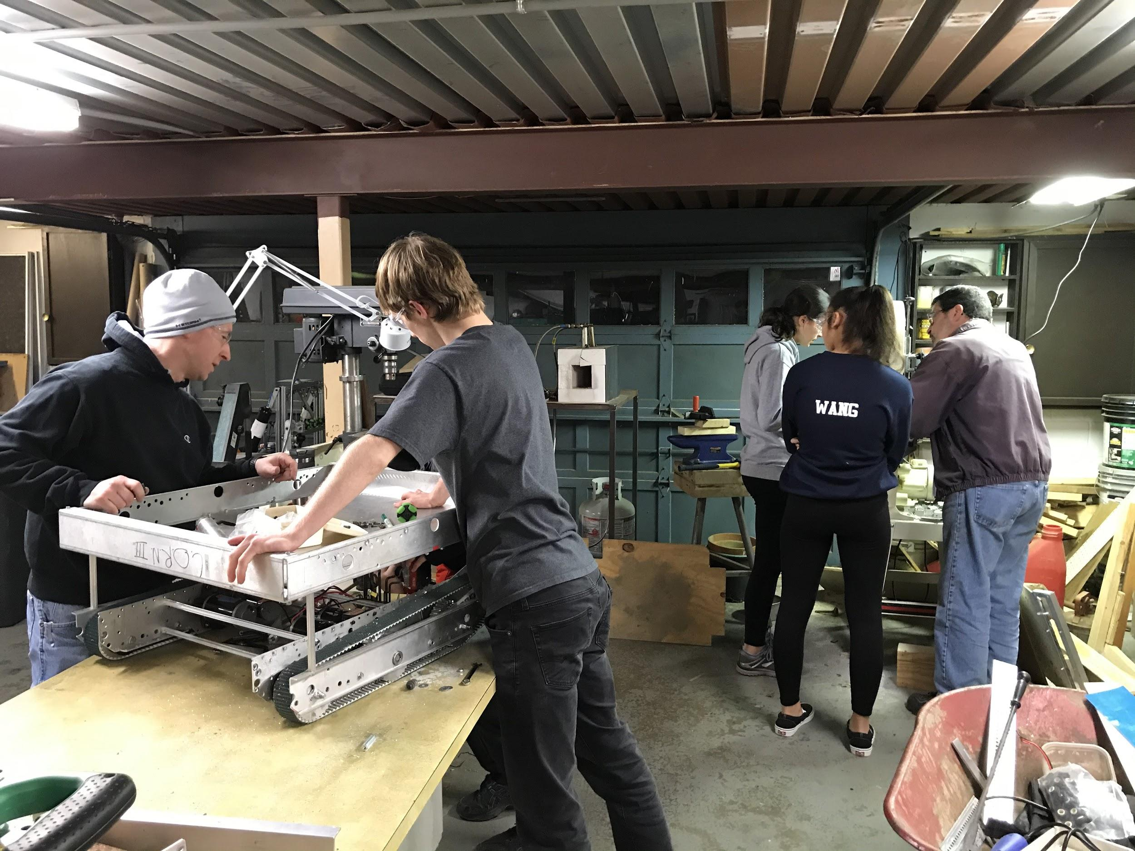
Mock Kickoff
Great way for new members to gain an understanding of the design process
Also good for team leaders and mentors to practice and prepare for kickoff
FRC 4150 students and mentors building a mock season robot to play Breakaway

Slide 16
Mock Kickoff Procedure
Select previous game that is unfamiliar to the team
Watch the game reveal
Review the game manual in detail to identify key elements
Brainstorm game strategy
Brainstorm robot design
If sufficient time proceed to mockup activities and maybe build a demo bot

Slide 17
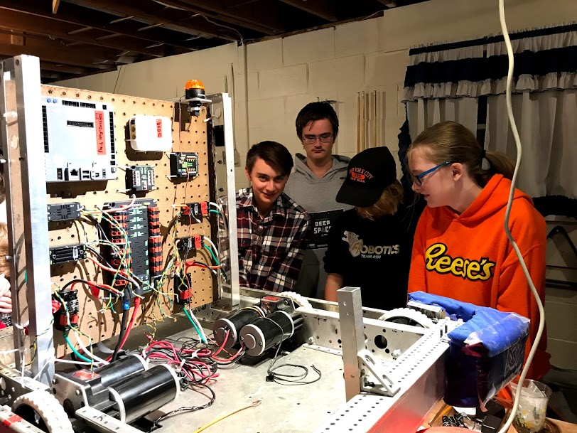
Technical Training
Wiring
Pneumatics
Motors and actuators
Control system theory
Software:
Language
Design
Configuration control
FRC 4150 wiring training

Slide 18
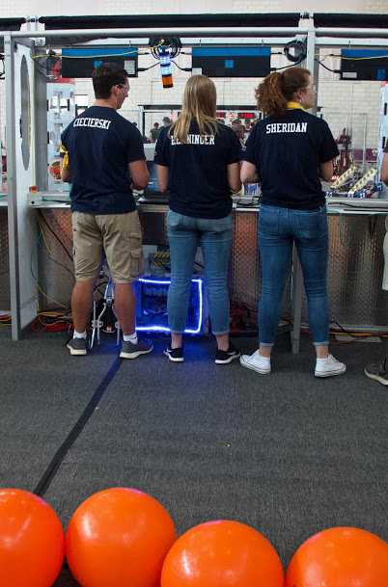
Off Season Competitions
Offseason competitions are a great way to:
Promote team building
Build drive team skills and develop new drive team members
Work on the skills required to maintain and improve your robot
Build relationships with other teams in your area
These events are also typically inexpensive to attend, especially if close enough to attend as single day events
FRC 4150 drive team at the 2019 Steel City Showdown

Slide 19
Credits
This lesson was written by FRC 4150 in partnership with FRC 8027 for FRCTutorials.com
You can contact the author at froboticsteam4150@gmail.com.
More lessons for FIRST Robotics Competition are available at www.FRCtutorials.com
This work is licensed under a
Creative Commons Attribution-NonCommercial-ShareAlike 4.0 International License.

